Slide 1
Red Dress TSEO Analysis
By Olivya Pastis

Slide 2
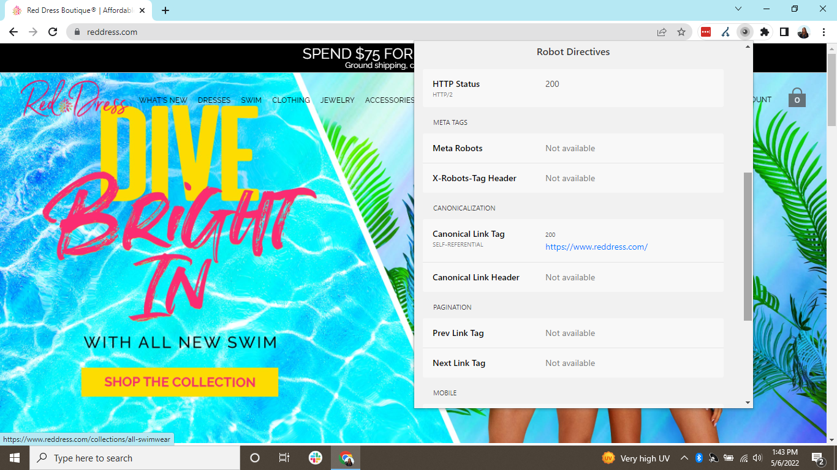

Problem 1: lack of meta robots
There is no presence of meta robots tags within the site
Meta robots tag: specifies whether search engines should index a page and/or follow the links appearing on that page
Signifies that quality content is being blocked from search engines or that low-value content is crawlable
Either situation can be harmful to a site depending on what is/isn’t indexable
Solution: include meta robots tag on the site

Slide 3
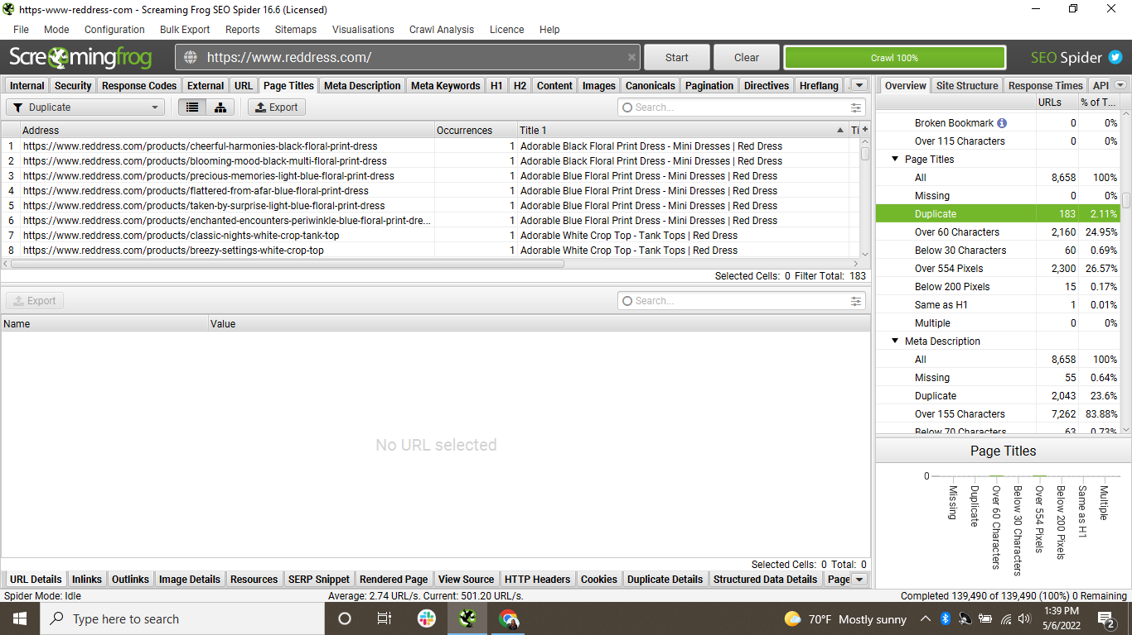
Problem 2: Duplicate titles
There are 183 pages that share page titles
Titles should be unique to a page
When 2 different pages have the same title, they compete against each other
Negatively impacts rankings on a search engine and bounce rate
Solution: write a unique page title for the pages listed or instead consolidate the content if it’s similar and creating internal competition within the site

Slide 4
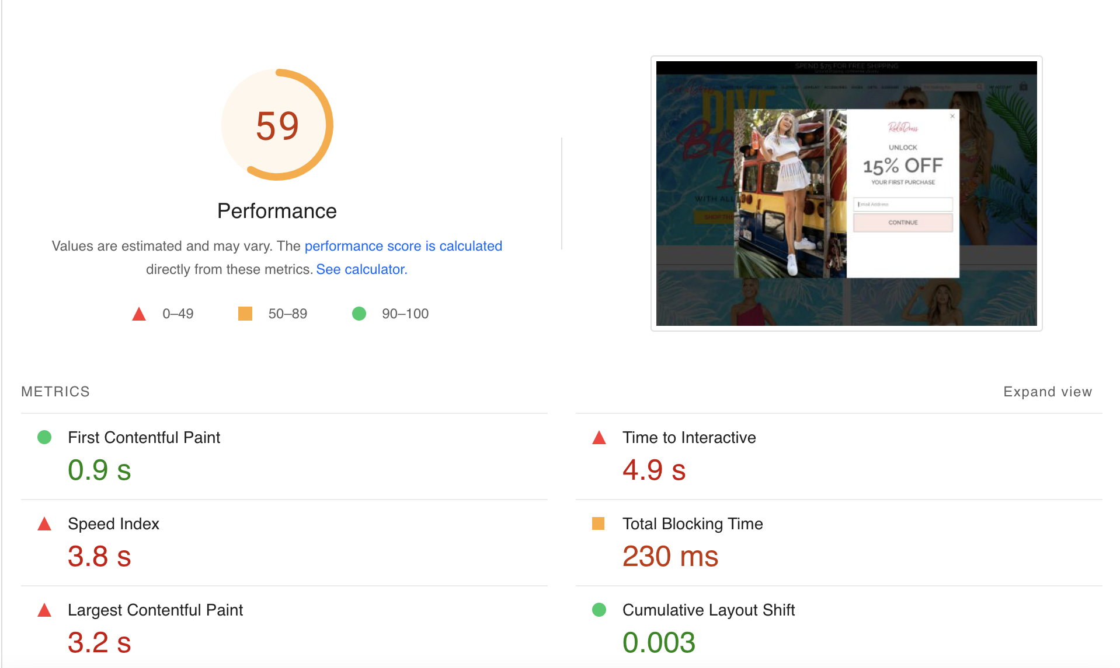
Problem 3: Slow page load time
Site failed the Core Web Vitals assessment, which is a Google ranking factor
Long duration of page load time negatively affects user experience, CWV performance scores, crawl budget, and organic rankings
Solution: ensure text remains visible during web-front load, use minification to reduce unused JavaScript and eliminate unnecessary elements within the code, and optimize images for faster page load time

Slide 5
Helpful resources
https://terakeet.com/blog/page-load-time/
https://www.screamingfrog.co.uk/seo-spider/tutorials/
https://devrix.com/tutorial/analyze-web-page-performance-using-google-pagespeed-insights/
https://www.movingtrafficmedia.com/are-duplicate-title-tags-bad-for-seo/
https://moz.com/learn/seo/robots-meta-directives
https://www.semrush.com/blog/bounce-rate/
https://invenioseo.com/minification/

Slide 6
Thank you!

